Slide 1

PickMeLast
Sports pooling application
Team 4

Slide 2
About
Pick me Last is a sports pooling application for individuals to play sports together
A user logs into the application selects a game and allows others to join in
A user can create or join an open game
It’s the app that connects active sports enthusiasts

Slide 3
Motivation
Technology is currently geared to simplify daily activities
Active sports culture is on the rise thus the need to leverage technology to make to
Improve manual processes around it

Slide 4
System Architecture

Slide 5
System Use Case

Slide 6
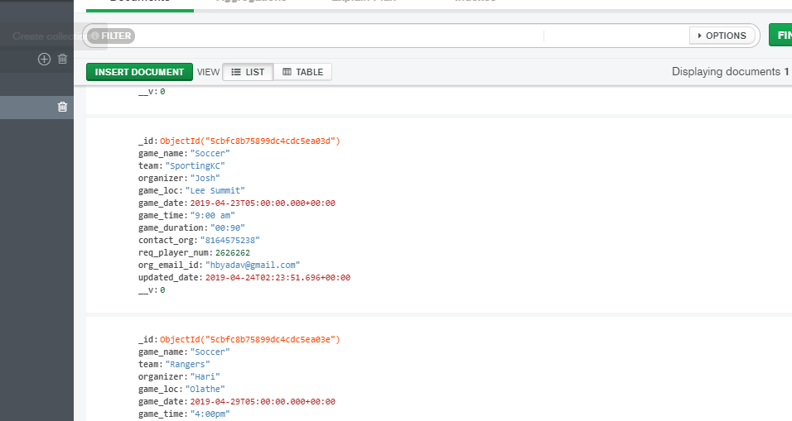
Database: MongoDb

Slide 7
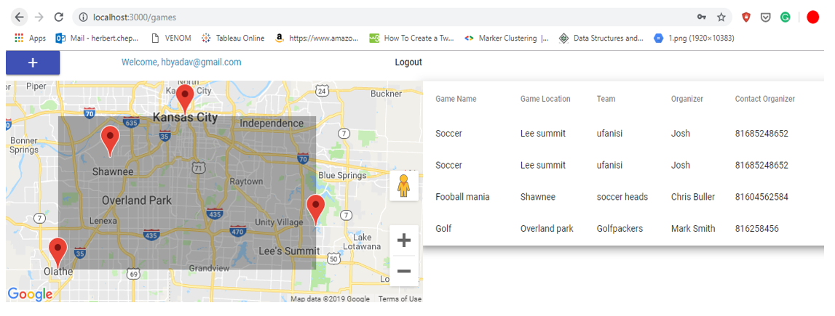
Games Details Dashboard
Active events Game Details
Locations with active events

Slide 8
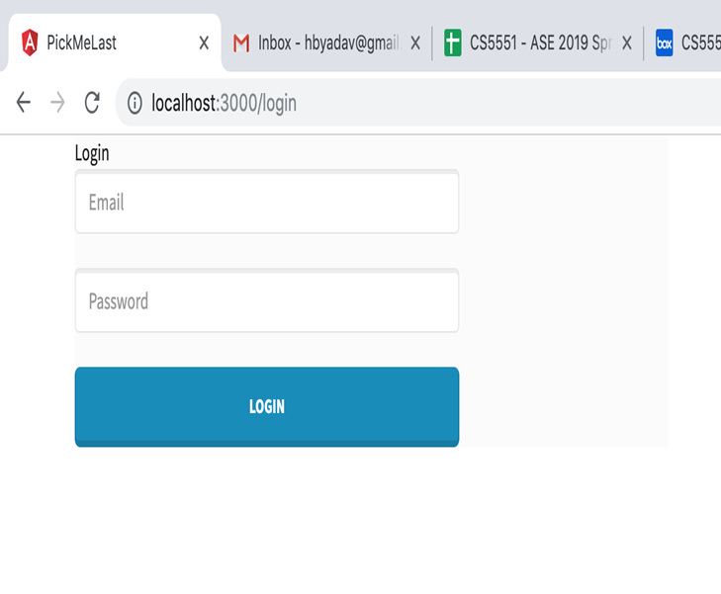

Slide 9
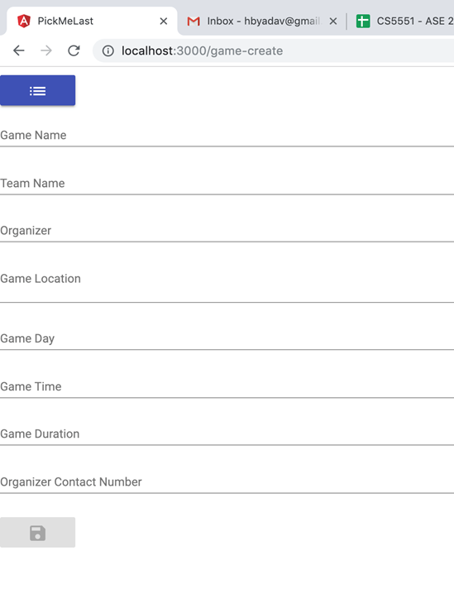
s

Slide 10
Future prospects
Add a Sharing system to create social network events e.g facebook events
Implement a cross platform application for pick me last
Metrics dashboards to offer sports data

Slide 11


